Slide 1
Cosmology from optical interferometry of AGNs
... in the visible
Optical Interferometry in the Visible
OCA, Nice, January 15-16, 2015
Romain G. Petrov,
Lagrange Laboratory (OCA, UNS, CNRS), Nice, France
with
Suvendu Rakshit, Florentin Millour, Sebastian Hoënig, Anthony Meilland, Stephane Lagarde, Makoto Kishimoto, Alessandro Marconi, Walter Jaffe, Gerd Weigelt...
Notes:
----- Notes de la réunion (30/05/13 15:11) -----
ok
----- Notes de la réunion (14/01/15 16:36) -----
Titre et sources...

Slide 2
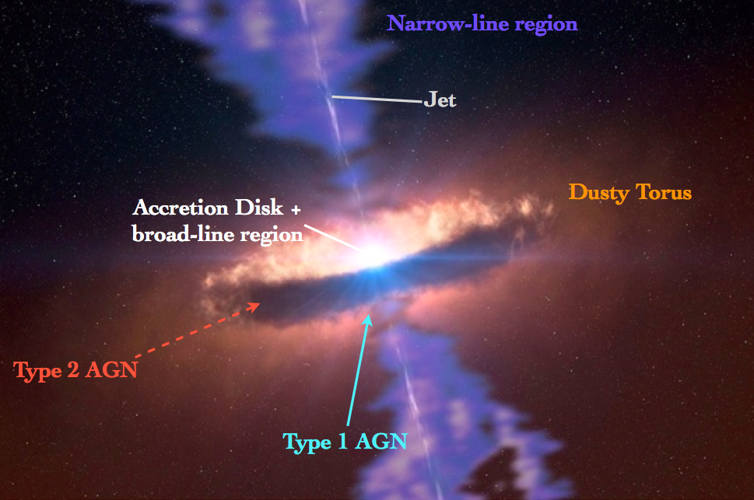
Introduction:
Structure and physics of AGNs
Notes:
----- Notes de la réunion (14/01/15 16:36) -----
Make an outline slide:
- Main interest in the visible: the BLR
- VLTI case: unresolved BLRs observed by Differential Visibility and Differential phase
- post VLTI case: baselines and limiting magnitude needed to make BLR images
- check "non BLR" science (Makoto, Sebastian)
- gas in the Taurus issue (Walter)

Slide 3
Typical scales
Accretion disk: ld(s) μas indirect constraints from luminosity distribution
BLR: 100 ld(s) 0.01 – 0.1 mas imaging requires 1-10 km baselines in V
Reverberation mapping constraints on geometry and
kinematics with cosmological potential
differential interferometry in K band
better differential interferometry in V ?
Torus (inner rim): 0.5-1pc 0.05 – 5 mas a few images with MATISSE in L band
Gas “in the torus” could be imaged in V
and constrain torus kinematics
Relationship with BLR ?
NLR (inner outflow): 1-10 pc (?) 0.05-50 mas imaging
BLR like scaling functions with luminosity ?

Slide 4
Outline
Focus on BLR observations
Reverberation Mapping
  size-luminosity law and cosmology
  mass-luminosity law and SMBH and Galactic evolution
Interferometric direct distance measurements from Dust
  Complexity of geometry and need for a new unification step
Differential interferometry of BLRs
The observed is not that was expected: the 3C273 case
The potential of the K band
The potential of the Visible, with UTs, ATs and a post VLTI interferometer
Conclusion

Slide 5
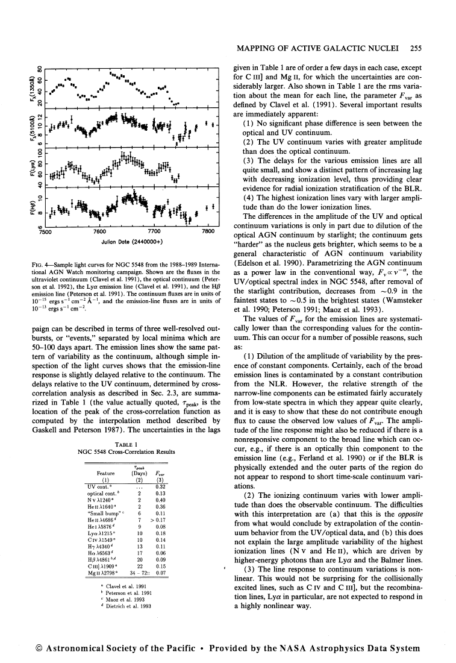
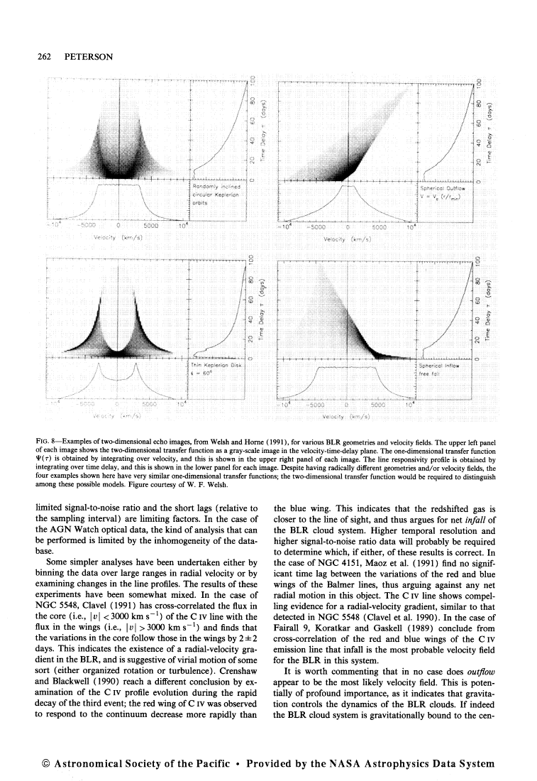
Reverberation mapping

Slide 6
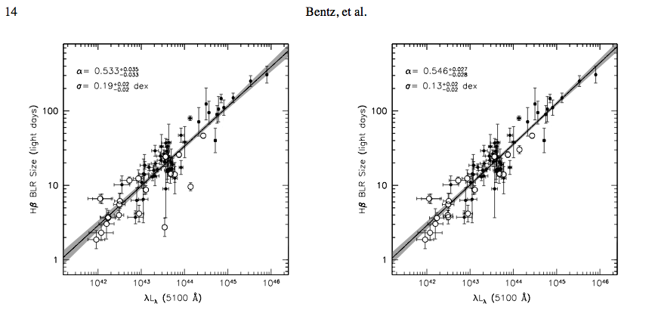
Reverberation Mapping, cosmology and galactic evolution
Structure and physics of AGNs
Reverberation mapping yields Size-luminosity and Mass-luminosity laws
Mass-luminosity laws from variability
Use QSO as standard candles and mass tags
Geometry dependent laws
Bentz, A&A, 2013
Kaspi, A&A, 2000
Notes:
----- Notes de la réunion (14/01/15 16:36) -----
Variability

Slide 7
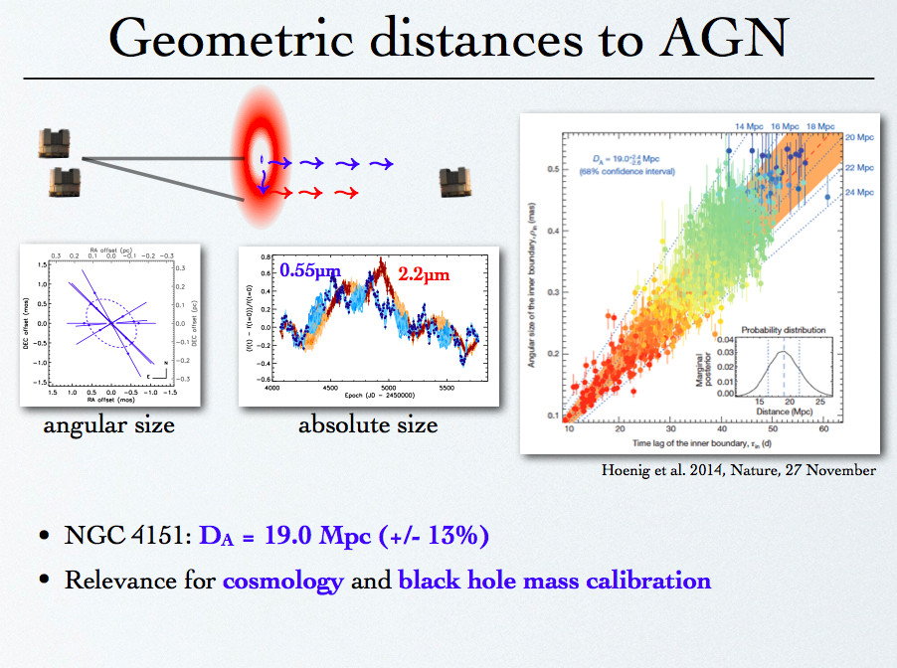
Notes:
----- Notes de la réunion (14/01/15 16:36) -----
Insist on the importance of geometric modeling

Slide 8
A complex, luminosity dependent structure
Kishimoto, OCA, 2013
Can we consider a “grand unification” involving luminosity
and luminosity as a function of latitude ?

Slide 9
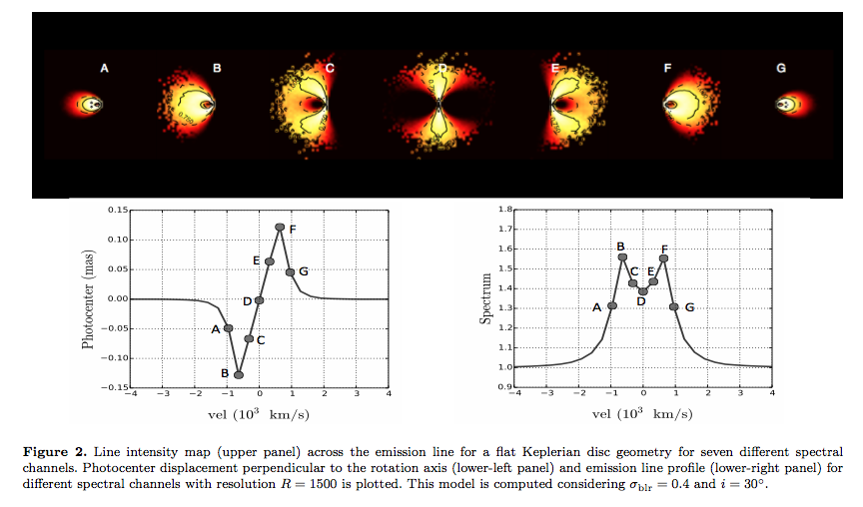
Differential interferometry of BLR
Images on resolved sources
Unresolved source:
  Differential Visibility =size of the bin
  Differential phase =position of the bin
Rakshit, MNRAS, 2015

Slide 10
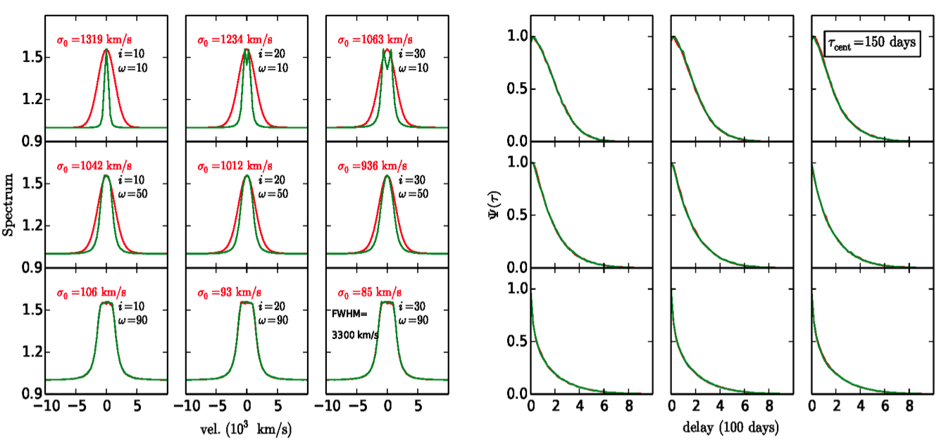
Differential interferometry and RM:
RM signals
Full degeneracy between
  inclination
  opening angle
  local velocity field (turbulence)
inclination
opening
Rakshit, MNRAS, 2015

Slide 11
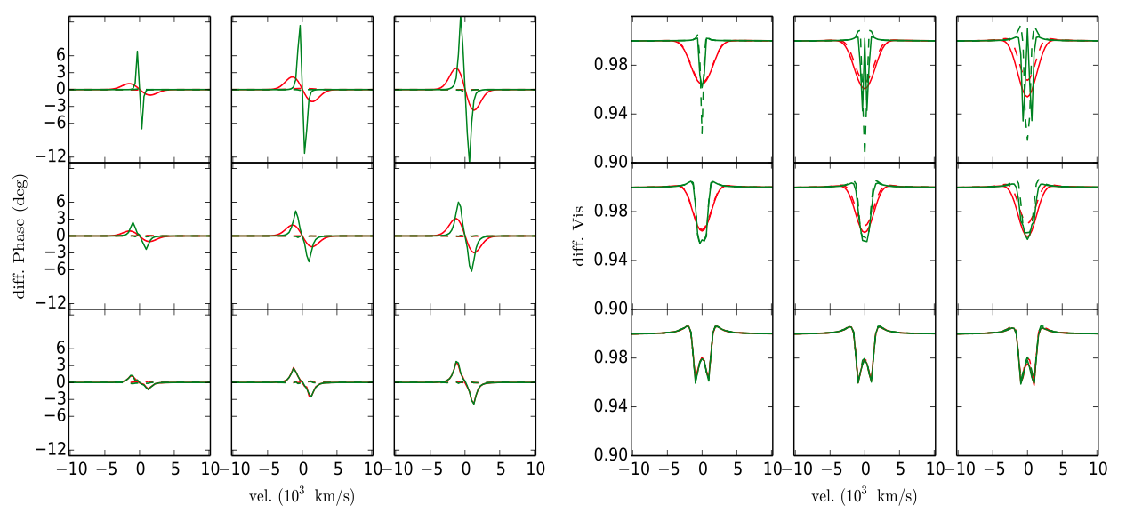
Differential interferometry and RM:
Differential interferometry signals
Remove degeneracy between
  inclination
  opening angle
  local velocity field (turbulence)
inclination
opening
Rakshit, MNRAS, 2015

Slide 12
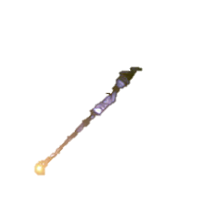
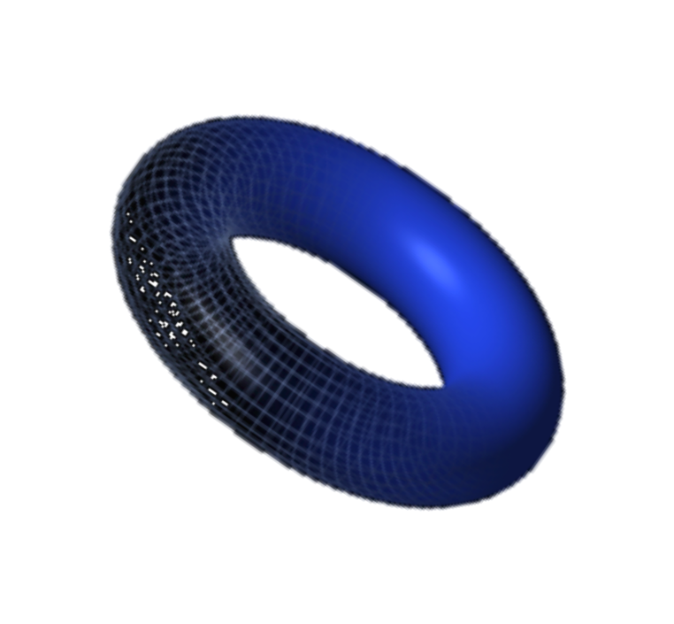

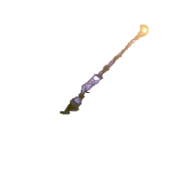
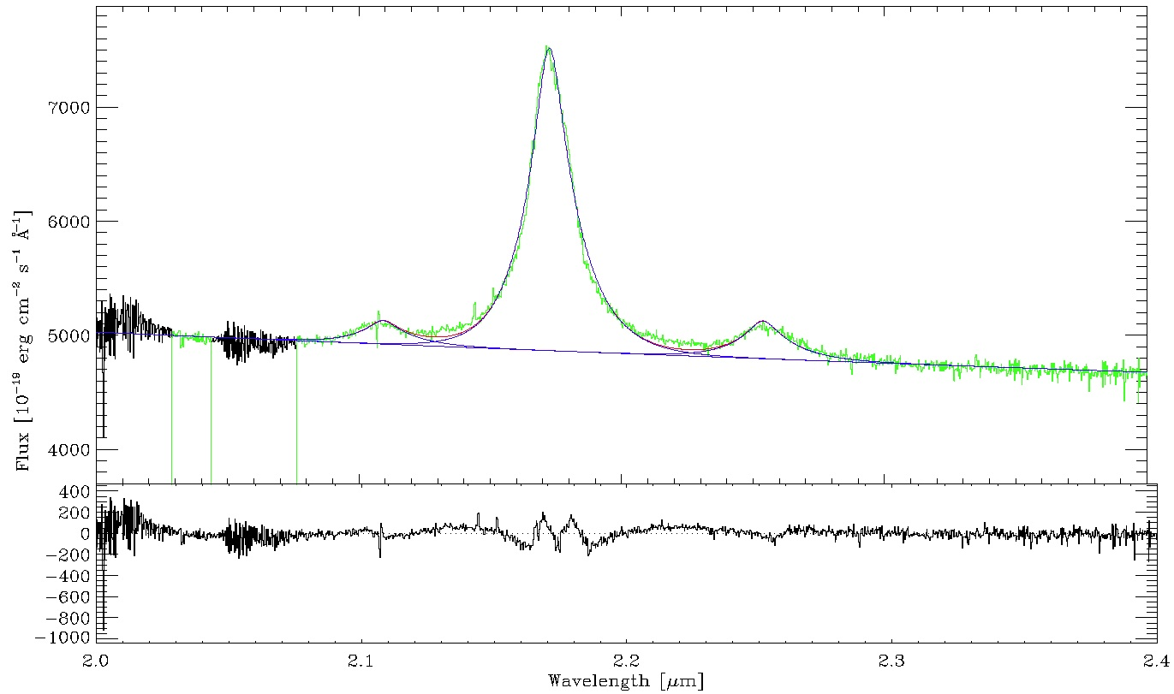
Differential interferometry of BLRs: 3C273
Brightest “nearby” QSO, K=9.7, L=6 10⁴⁶ erg/s.
  K=9.8 in continuum; K=9.2 on top of line
z=0.16
  Pa_{α} line at 2.17 microns
Reverberation mapping radius: 240 to 580 ld
  R_{BLR}=307₋₉₁⁺⁶⁹ ld = 0.10 mas in H_{γ}
  R_{BLR}=514₋₆₅⁺⁶⁴ ld = 0.16 mas in H_{α}
M_{BH}~ 2 to 5 10⁸ M_{sun} (Kaspi, 2000)
  ~ 60 10⁸ M_{sun}, (Paltani, 2005)
Radius of inner rim of torus
  R_{T} ≈ 0.81±0.34 pc=0.30±0.12 mas (Kishimoto 2011)
VLTI resolution in K band: 3.5 mas
  Very unresolved target
    ➔ Differential Interferometry
  Too faint for standard AMBER operation
MR limiting magnitude set by fringe tracker <8.5
Notes:
Figure additionelle: les signaux attendus (...
Misty Bentz told us yesterday...
----- Notes de la réunion (14/01/15 16:36) -----
Put back some Data reduction stuff from Hires 2014 talk?

Slide 13
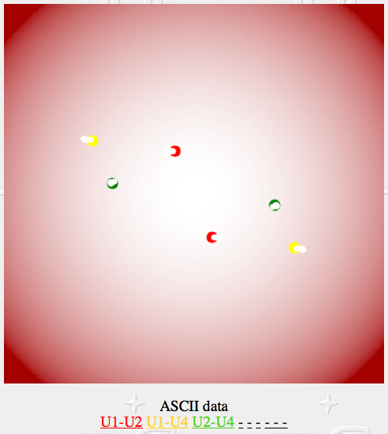
3C273: what did we expect?
jet
For a flat Keplerian model and R_{BLR}=0.15 mas
Differential visibility up to 2%
Differential phase up to 4°
  i.e. 40 μas photocenter displacement
  up to 2° if jet direction is BLR axis
Petrov, Hires 2014

Slide 14
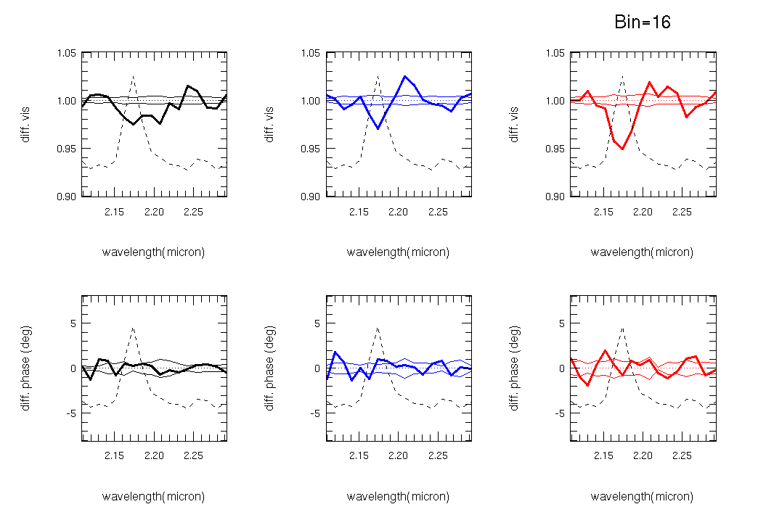
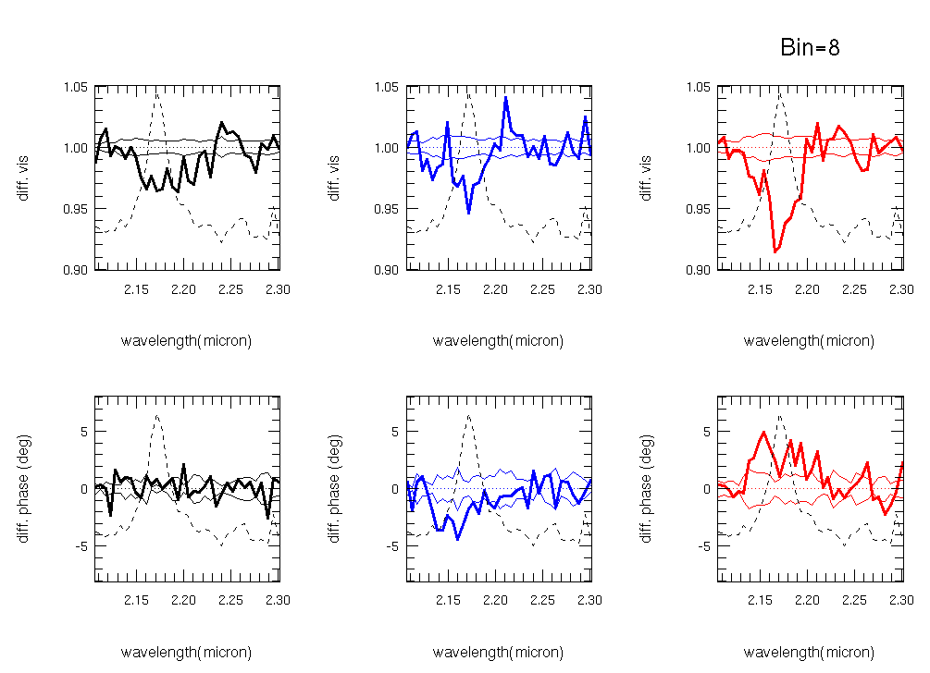
3C273 measures
resolution=240
Differential visibility accuracy <0.01 per channel
Visibility drops on all baselines (SNR=10 on largest baseline)
Differential visibility drop extends over full line
Differential phase = 0±0.5° per channel of 1250 km/s
Petrov, Hires 2014
resolution=480
Notes:
----- Notes de la réunion (14/01/15 16:36) -----
Differential phase is not mentioned

Slide 15
BLR angular size
The BLR is much larger than the inner rim of the dust torus
All model fits give angular radius between 0.43 and 0.70 mas (FWHM)
This would be accessible to imaging in the visible
That is 1300 ld < R_{BLR}< 2100 ld instead of 240 ld < R_{BLR}< 580 ld
Distance ?
Difference between Pa_{α} and H_{α} lines ?
Different weights in averaged size in RM and DI?
RM wrong ? YES!
  For this specific very large source, the observing time window (2300 days is too short to properly measure any delay larger than 800 days)

Slide 16
Biased Reverberation Mapping of 3C273
Take 3C273 continuum light curve (S. Kaspi et al, ApJ 2000)
Produce 500 interpolations of this light curve (damped random walk model, Y. Zu et al, ApJ 2011)
For each continuum light curve, produce a line light curve, with a time delay τ_{in}.
Compute the RM cross-correlation function, deduce a measured time delay τ_{out} and plot τ_{out} = f(τ_{in}).
Reverberation Mapping with the 3C273 observation window, cannot measure BLR sizes larger than 800 light days.
  For larger time lags,
  it yields BLR size estimates in 200-500 ld range
  Other interpolation methods give similar results
Petrov, Hires 2014
Notes:
----- Notes de la réunion (14/01/15 16:36) -----
More details in additionnal slides

Slide 17
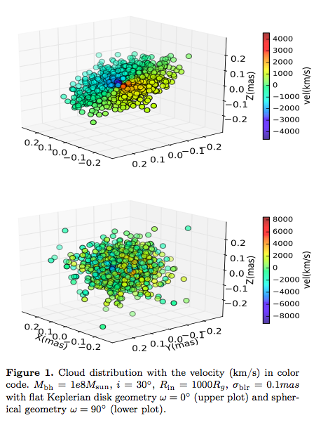
BLR model
“cloud list” model
Radial distribution and R_{BLR}
Inclination
Opening angle
Local line profile(s) & width
Turbulent velocity
Rotation velocity law (Keplerian)
Radial velocity law
...
Rakshit, MNRAS, 2015

Slide 18
Global fit
R_{BLR}=0.63±0.1 mas
  R_{BLR}=0.63±0.1 mas
  R_{BLR}=1880±30 ld
Inclination not really constrained below i<15°
Opening angle larger than 85°
Turbulent velocity field 1500 km/s
Mass little sensitive to inclination: M_{BH}=5.4_{-0.4}^{+0.2} M_{sun}
Petrov, Hires 2014
Add 20% relative error to R_{BLR} and to M_{BH}
because of uncertainty on (absolute visibility in continuum ⬄ inner rim size)

Slide 19
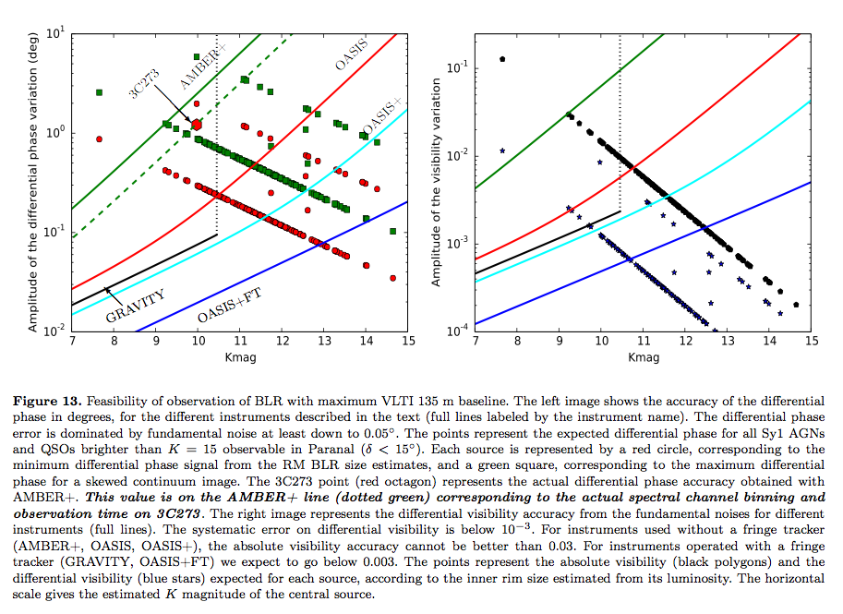
Observing BLRs in the K band
Notes:
----- Notes de la réunion (14/01/15 16:36) -----
Show MATISSE curve in the L band (in the MATISSE GTO proposal)

Slide 20
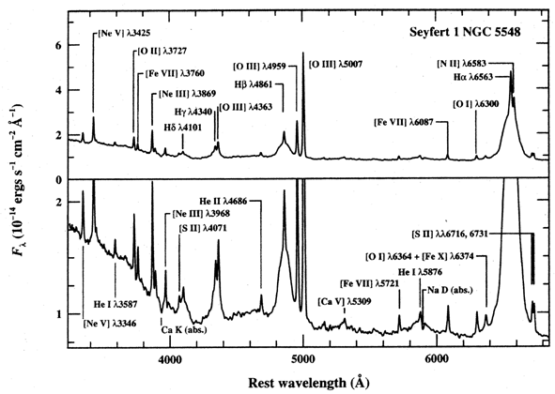
Observing AGNs in the Visible
Notes:
Much stronger lines: H_alpha ~ 3 Pa_alpha ~ 30 Br_gamma

Slide 21
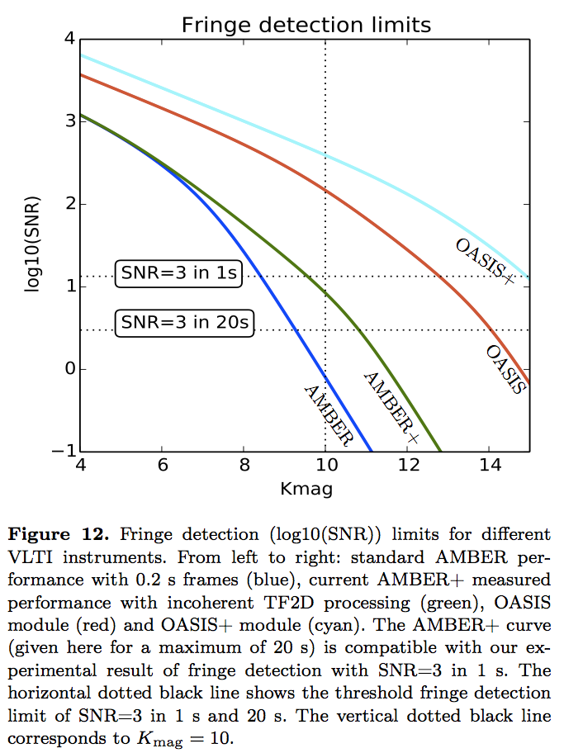
Fringe detection limits in the K band in the visible
OASIS+ (Best K band instrument) UTs K_{lim}=15
  K band, 2.2 μm, R=1500
  σ_{R}=3e⁻, n_{p}=4
  DIT=0.1s
  N_{exp}=200 (20s)
  Strehl=0.5, transmission 2%
VISIBLE instrument UTs V_{lim}=15
  550 to 750 nm, R=1500
  photon counting
  DIT=0.023s
  N_{exp}=44 (1s)
  Strehl=0.23, transmission 2%
VISIBLE instrument ATs V_{lim}=15
  ...
  N_{exp}=3564 (81s)
  Strehl=0.5, transmission 2%
VISIBLE instrument ATs V_{lim}=14
  ...
  N=120 (12s)
  Strehl=0.5, transmission 2%
Visible
UT, S_{t}=0.23
1 s
Visible
AT, S_{t}=0.5
12 s
V_{mag}

Slide 22
Target list
We investigate all QSOs and Sy1 AGNs observable at Paranal (δ<15°)
With K_{mag}<15 and V_{mag}<15 ➔ ~ 130 targets
Notes:
----- Notes de la réunion (14/01/15 16:36) -----
Show MATISSE curve in the L band (in the MATISSE GTO proposal)

Slide 23
Observing BLRs in the Visible
UTs S_{tr}~0.25 between 0.55 and 0.75 nm R=1500 2 hours
  σ_{φ}(V=15) ~ σ_{φ}(K=15) if S_{trK}=0.5 and S_{trV}=0.23
  Φ_{diffV} = Φ_{diffK}*50 (resolution gain and use of H_{α} instead of Br_{γ}
  V_{diffV} = V_{diffK}*160 (resolution gain)² and use of H_{α} instead of Br_{γ}
  Absolute visibility and differential phase on all sources V<15
  Distance accuracy better than 5% at V=14 (~30 sources with distances better than 5%)
10²
10⁰
10¹
10⁻¹
10⁰
10⁻²
10⁻¹
10⁻³
Vmag
Vmag
Notes:
----- Notes de la réunion (14/01/15 16:36) -----
Show MATISSE curve in the L band (in the MATISSE GTO proposal)

Slide 24
Observing BLRs in the Visible
ATs S_{tr}~0.5 between 0.55 and 0.75 nm R=1500 2 hours
  σ_{φAT}(V=15) ~ σ_{φUT}(K=15)*3 if S_{trKUT}=0.5 and S_{trVAT}=0.5
  Φ_{diffV} = Φ_{diffK}*50 (resolution gain and use of H_{α} instead of Br_{γ}
  V_{diffV} = V_{diffK}*160 (resolution gain)² and use of H_{α} instead of Br_{γ}
  Absolute visibility and differential phase on all sources V<14
  Distance accuracy better than 5% at V=13 (~10 sources with distances better than 5%)
10²
10⁰
10¹
10⁻¹
10⁰
10⁻²
10⁻¹
10⁻³
Vmag
Vmag
Notes:
----- Notes de la réunion (14/01/15 16:36) -----
Show MATISSE curve in the L band (in the MATISSE GTO proposal)

Slide 25
Conclusion for OIV observations of AGNs
With the VLTI
  Very few BLR images (and access to V>13 necessary)
  UTs with fair AO in the Visible (S_{tr}~0.2)
    V_{lim}=15
    130 targets with full modeling and direct distances (60 targets in K band)
    Distance accuracy improved * 50 with regard to the K band
  ATs with good AO in the Visible (S_{tr}~0.5)
    V_{lim}=14 (?) This is the real frontier
    ~30 targets, much better modeling because V/σ_{V} * 50 with regard to the K band (UTs)
    Distance accuracy improved * 16 with regard to the K band (UTs)
  Visible VLTI instrument would improve very substantially the calibration of RM mass-luminosity and size-luminosity laws and calibrate RM distance measurements
With a post VLTI interferometer
  imaging BLRs needs 1-10 km baselines
  V_{lim} must be close to 15 ➔ 3-4 m telescopes with S_{tr}~0.5
  PFI with good quality telescopes in the visible...

Slide 26
Additional slides

Slide 27
Summary for AGN dust tori results
Clumpy torus (indeed)
Near-IR sizes factor 3 smaller than anticipated; (2)
Surface emissivity ~0.3 pointing to high emissivity (>0.1) = large grains
Bulk of mid-IR emission (>50-80%) comes from polar region, which has not been expected.
This seems luminosity dependent: higher polar excess at low luminosity: Luminosity dependent structure
Direct distance measurements
  but morphology dependent
MATISSE will make images of an handful of QSOs

Slide 28
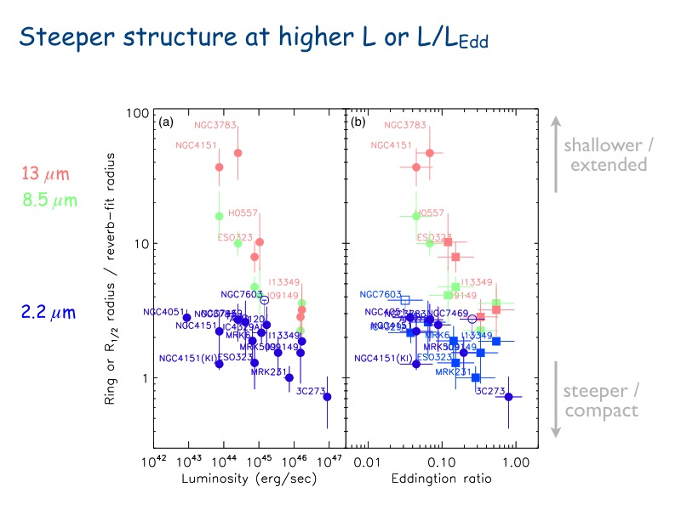
Size of dust torus
Kishimoto, A&A, 2011
Notes:
----- Notes de la réunion (14/01/15 16:36) -----
Title
Luminosity dependance of torus structure

Slide 29
Conclusion for IR VLTI observations
Optical interferometry could provide enough measures by 2020 to:
Measure the morphological parameters of 60 QSOs and Sy1 AGNs
  angular size, radial distribution of clouds, latitudinal distribution of clouds, local-to-global velocity ratio, radial-to-rotation ratios,
  study this parameters as a function of luminosity, RM key measures, light curve parameters
Calibrate Mass-Luminosity and Size-Luminosity laws
Calibrate GAIA morphology dependent biases on QSOs
Masses and direct distances from GAIA luminosity and variability measures.
Notes:
Update for Visible

Slide 30
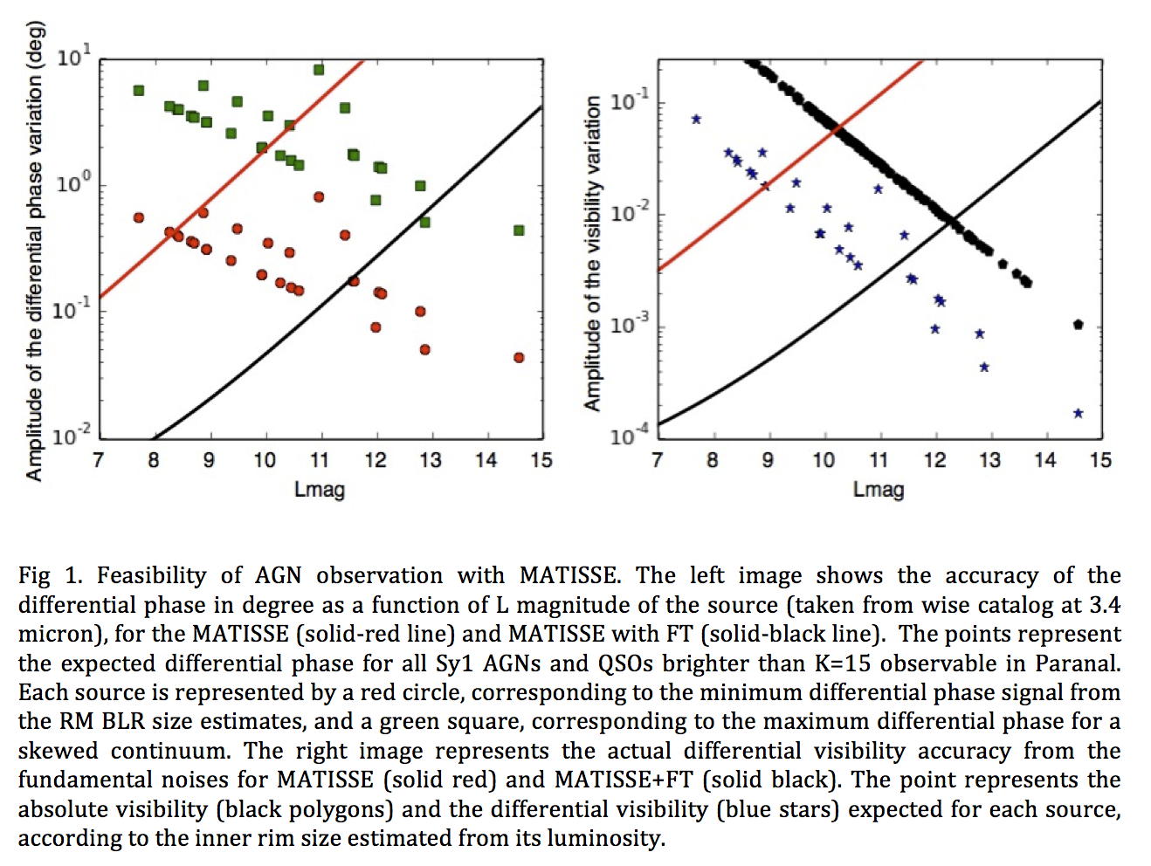
Observing BLRs with MATISSE

Slide 31
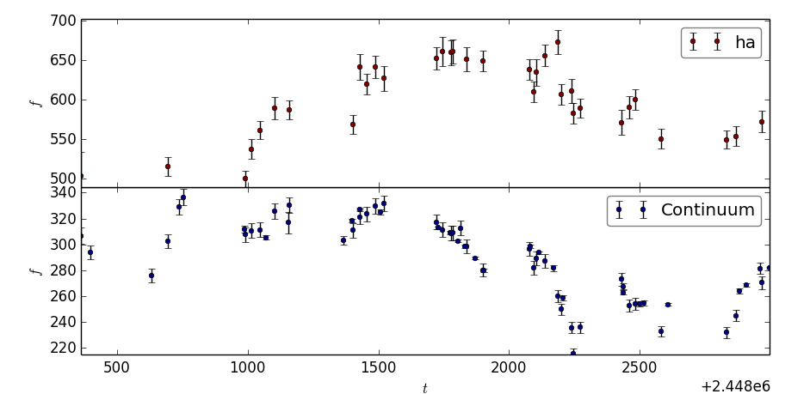
Biased Reverberation Mapping of 3C273
Take 3C273 continuum light curve (S. Kaspi et al, ApJ 2000)

Slide 32
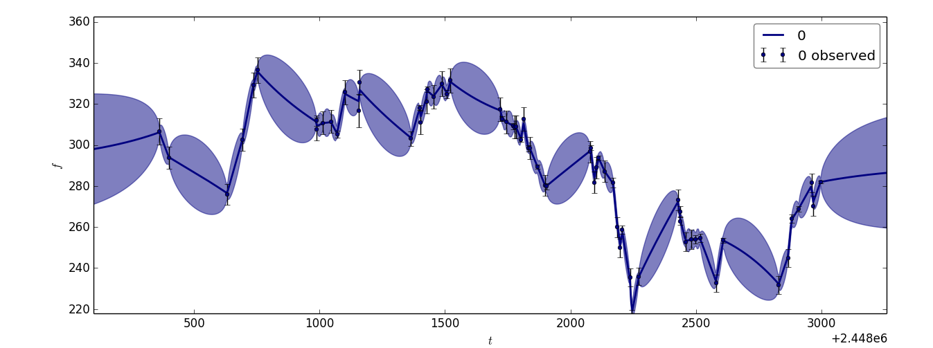
Biased Reverberation Mapping of 3C273
Take 3C273 continuum light curve (S. Kaspi et al, ApJ 2000)
Produce 500 interpolations of this light curve (damped random walk model, Y. Zu et al, ApJ 2011)

Slide 33
Biased Reverberation Mapping of 3C273
Take 3C273 continuum light curve (S. Kaspi et al, ApJ 2000)
Produce 500 interpolations of this light curve (damped random walk model, Y. Zu et al, ApJ 2011)
For each continuum light curve, produce a line light curve, with time delay τ_{in}.

Slide 34
Biased Reverberation Mapping of 3C273
Take 3C273 continuum light curve (S. Kaspi et al, ApJ 2000)
Produce 500 interpolations of this light curve (damped random walk model, Y. Zu et al, ApJ 2011)
For each continuum light curve, produce a line light curve, with a time delay τ_{in}.
Compute the RM cross-correlation function, deduce a measured time delay τ_{out} and plot τ_{out} = f(τ_{in}).

Slide 35
Last minute results
Differential phase on longest baselines
Broad, asymmetric, blue shifted signal
  BLR or dust clouds anisotropy makes a symmetric signal
Need model of BLR
  partially shielded by torus
  with a slight outflow
  ...
Notes:
----- Notes de la réunion (14/01/15 16:36) -----
Differential phase aspect

Slide 36
Dust tori interferometry

Slide 37
Steeper / Shallower structure

Slide 38
Discussion
The high L (or high Eddington ratio) sources seem to have a much more stepper dust distribution
Possible explanation: radiation pressure on dust
  Possible anisotropic illumination
    anisotropy of acc. disk (Netzer 1985; Kawaguchi 2011)
    Shielding in equatorial plane
  Interferometric measurements of elongation in the polar direction (polarization direction) (Hoenig, 2012, 2013)
    Dusty wind ?
  There are models for efficiently blown away dusty gas (e.g. Semenov 2003)
High L: polar region cleared by radiation pressure
Low L: polar dusty wind
Notes:
shielding by the BLR in the equatorial plane ?
But not by a 3c273 like BLR

Slide 39
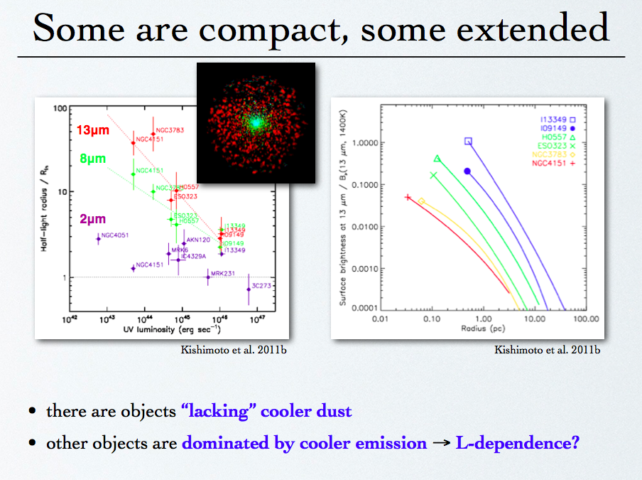

Slide 40
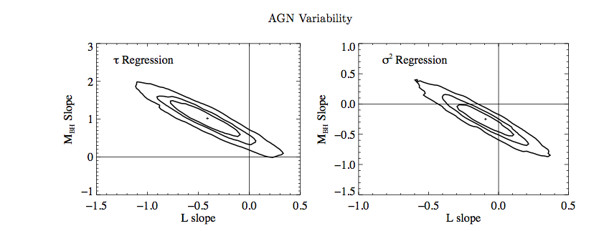
Mass and Luminosity from variability
B.C. Kelly 2009
Notes:
Tau est un “relaxation time” of the process underlying the time variation.

Slide 41
AMBER+ is a new observation mode and 2DFT data reduction that works for SNR per channel and per frame <<1
=> gain > 2 magnitudes
K=4
K=8.5
K=10
3C273 fringe peaks (10 s)
Notes:
Courbes de SNR, notamment pour 4 telescopes.

Slide 42
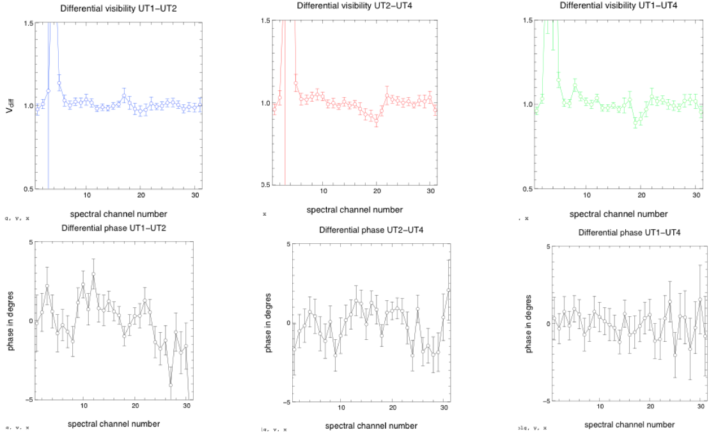
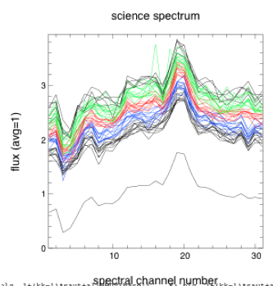
First results, first problems
Differential visibility
  V_{diff}(50m) =0.98±0.03
  V_{diff}(80m) =0.94±0.04
  V_{diff}(125m)=0.92±0.04
Differential phase
  Φ_{diff} <0±2°
R_{BLR}> 0.5 mas, i.e. > 1500 ld
Results show artifacts

Slide 43
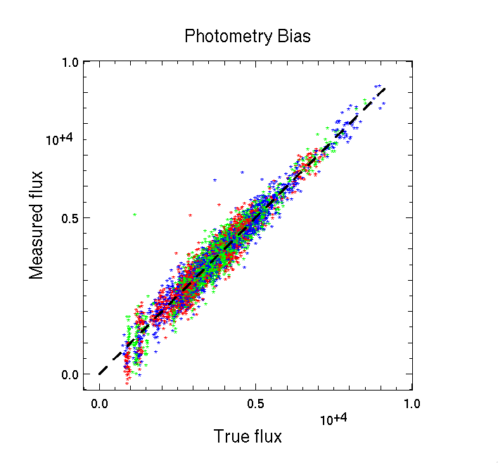
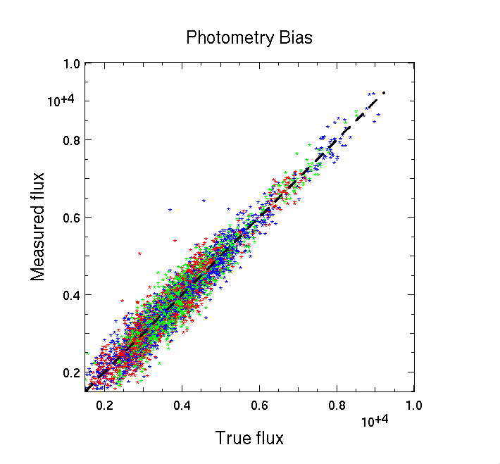
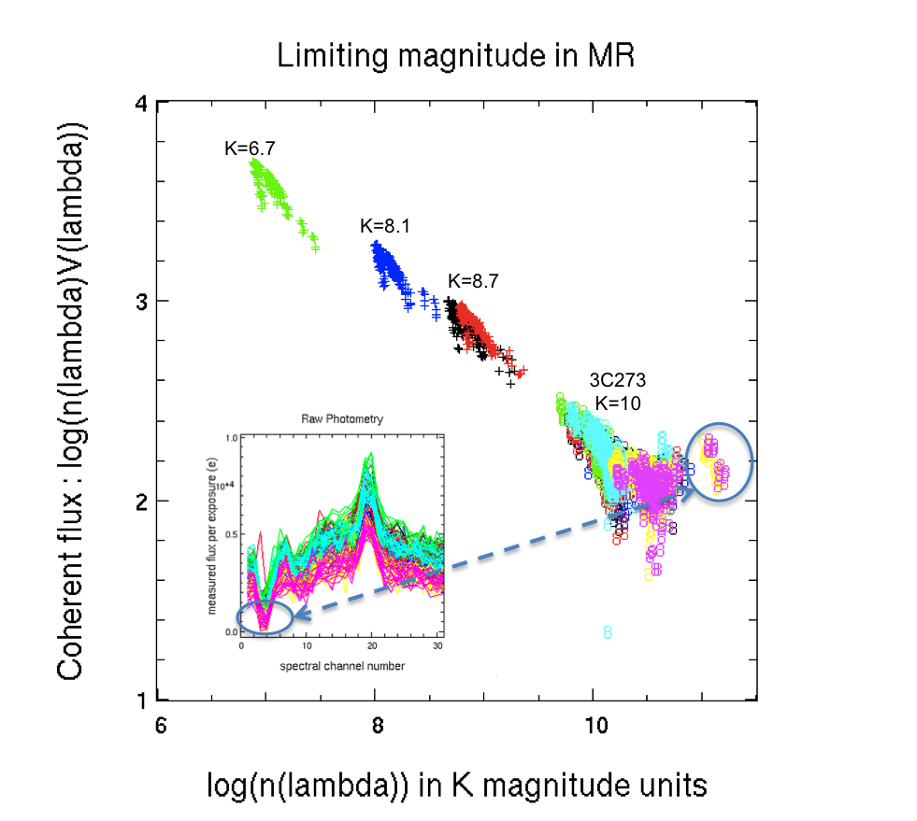
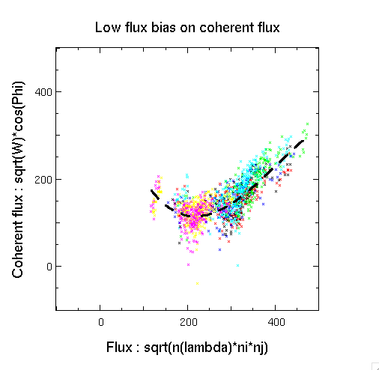
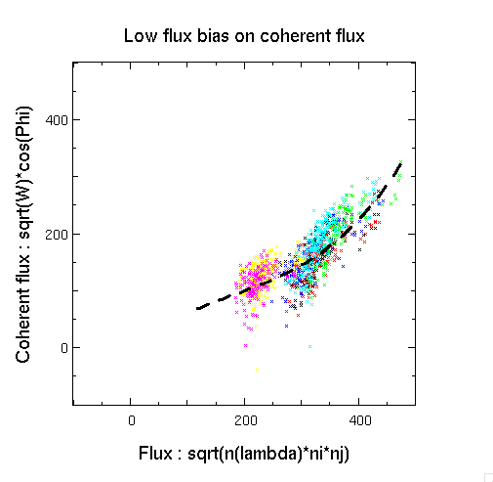
Bias analysis

Slide 44
Bias cancelation
Eliminate channels with equivalent magnitude K>11.5
  (might be probably K>12.5 now)
Apply bias correction law fitted on calibrator
Fit results with law order polynomial function in continuum

Slide 45
Final measures
resolution=240
Differential visibility accuracy <0.01 per channel
Visibility drops on all baselines (SNR=10 on largest baseline)
Differential visibility drop extends over full line
Differential phase = 0±0.5° per channel of 1250 km/s
resolution=480

Slide 46
BLR structure
Flat BLRs with global velocity field seem excluded
With such a large BLR, to cancel the differential phase, we need:
A very small inclination
  Line and visibility profile width entirely due to local velocity
  Very poor fits
If i>10°
  global velocity field large enough to explain line width ➔ large differential phase
  need large opening angle
  and/or large turbulent velocity field

Slide 47
Global fit
R_{BLR}=6.26±0.1 mas
  R_{BLR}=6.26±0.1 mas
  R_{BLR}=1880±30 ld
Inclination not really constrained below i<15°
Opening angle larger than 85°
Turbulent velocity field 1500 km/s
Mass little sensitive to inclination: M_{BH}=5.4_{-0.4}^{+0.2} M_{sun}

Slide 48
Conclusion and perspective on BLRs in the K band
Our VLTI/AMBER measures on 3C273 are real
The BLR of 3C273 is much larger than the dust inner rim
The radius R_{BLR}=6.3±1.5 mas (1850±600 ld) is much larger than RM estimate
The BLR is very close to be a sphere (ω>80°)
The BLR mass estimate is 5.4±1.0 10⁸ M_{sun} (dominated by absolute visibility accuracy measure)
We are not fitting the s(λ) and V(λ) wings properly
  work on the radial distribution of luminosity
A better SNR would allow us to analyze the actual profiles of s(λ) and V(λ)
Measuring a differential phase would make a real difference
More targets...

